Slide 1
Canada Education Savings Program
April 2018

Slide 2
Importance of Post-Secondary Education
Children with education savings are more likely to attend and complete post-secondary education and graduate with less debt.
Post-secondary education does not only include university, it also includes:
Trade schools
Apprenticeship Programs
Colleges
CEGEPs
Helping more people access post-secondary education is a key way in which we can grow the economy and strengthen the middle class.

Slide 3
Benefits of Education Savings
Recent studies have indicated that:
Personal savings now represent the single most important source of funding for PSE for recent high-school graduates.
Children who are the beneficiaries of RESP savings are more likely to go to university. There is a 5.9% difference in post-secondary enrolment of children with, and without, education savings.
Any amount of savings has a greater impact on the attitudes and behaviours of children towards PSE than the actual amount of savings.
Education savings incentives:
Reinforce the importance of planning early for PSE;
Help Canadians build savings for PSE;
Contribute to making PSE more affordable by reducing reliance on loans; and
Reinforce aspirations for PSE through asset-building and savings.

Slide 4
Registered Education Savings Plan (RESP)
An RESP is a savings account that can:
help put money aside for a child’s post-secondary education;
allow savings for a child’s future studies to grow tax-free, until it is withdrawn for post-secondary education;
not only be used to help with the costs of tuition, but also housing, transportation, and other education-related expenses (e.g., textbooks, equipment, supplies, etc.); and
attract federal and where applicable, provincial education savings incentives.

Slide 5
Canada Learning Bond
The Canada Learning Bond (CLB) is available to eligible children from low-income families born in 2004 or later. It provides:
an initial payment of $500 into an RESP, as well as additional payments of $100 for each year of eligibility, up to age 15, and a maximum of $2,000.
No annual personal contributions are required to receive the CLB.
It is the primary caregiver (PCG) or, as of January 2018, their cohabiting spouse or common-law partner, who must request the CLB on behalf of an eligible child.
Beneficiaries can request the CLB payments that they have not received when they are between the ages of 18 and 21.

Slide 6
Canada Education Savings Grant
The Canada Education Savings Grant (CESG) consists of 20% amount of grant on the first $2,500 in annual personal contributions to an RESP, for a maximum of $500 per year, which is available to all eligible children regardless of family income, and an additional amount of CESG, which provides:
10% on the first $500 of annual personal contributions for children from families with an adjusted income between $46,605 and $93,208; or,
20% on the first $500 of annual personal contributions for children from families with an adjusted income income of $46,605 or less.

Slide 7
CESG and CLB Eligibility
Canada Education Savings Grant | Be up to 17 years of age*; Be a resident of Canada; Have valid Social Insurance Number’s; Be named as a beneficiary to an RESP; and, Have a contribution made to an RESP on their behalf .
Canada Learning Bond | Be born on or after January 1, 2004; Be a resident of Canada; Have valid Social Insurance Number’s; Be named as a beneficiary to an RESP; and, Be from a low-income family.
* Note: To be eligible for the CESG in their 16th or 17th year, certain RESP contribution requirements must have been met before the end of the year in which the beneficiary turned 15 years of age.

Slide 8
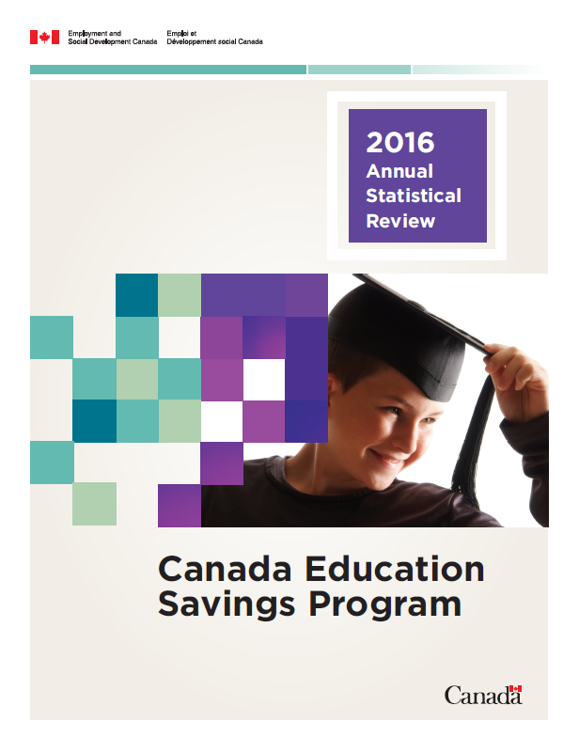
2016 Annual Statistical Report
Canadians held a total of $51.3 billion in RESP assets in 2016:
$4.43 billion was contributed by Canadians into RESPs in 2016;
Of note, $301 million was paid to children from low and middle income families - a 350% increase from $67 million paid in 2006.
In 2016, 546,141 children received $134 million in CLB.
Personal contributions were made into 77% of the RESPs that received a CLB payment (420,000 RESPs).
$3.56 billion was withdrawn from RESPs to help finance the post-secondary education for more than 419,611 students.
The 2016 ASR can be downloaded at: https://www.canada.ca/en/employment-social-development/services/student-financial-aid/education-savings/reports.html

Slide 9
Mailings
ESDC sends 30,000 to 80,000 letters on a quarterly basis, to inform newly eligible low-income families of their child’s eligibility for the CLB.
In 2017-18, ESDC sent almost 675,000 individuals letters to the PCGs of CLB-eligible children informing them of their child’s eligibility
Quarterly mailings to newly eligible children; adhoc collaborative mailings with CBOs; innovative, nudge mailings concepts.
Notes:
In 2016-2017, CESP sent 381,221 letters to PCGs of CLB-eligible children.
In 2017-2018, CESP plans to send approximately 7000,000 letters to the PCGs of CLB-eligible children:
The take-up rate for our standard letter is 8.8%.
CLB mailings trial with the Privy Council Office Innovation Hub – February 27, 2017 (65,000 letters)
Joint-mailing with BC to notify of BC Training and Education Savings Grant (BCTESG) eligibility – March 16, 2017 (65,949 letters)
Education Savings Week (November 19-25, 2017) - Mailings designed to drive individuals to CLB sign-up events in their neighbourhoods during. See slide.
Mailing to PCGs of thirteen year olds about to enter high school (October, 2017) – first time conducting targetted mailings to older children. Results will be available in April 2018.
Other planned mailings:
PCGs of children about to enter kindergarten

Slide 10
CLB Champions’ Network
The CLB Champions’ Network is a network of non-governmental organizations, community services providers, financial institutions, philanthropic organizations, and all levels of government working to raise awareness, understanding, and take-up of the CLB among low-income households.
The following is just a sample of the members of the CLB Champions’ Network:
Notes:
CESP is increasingly seeking to leverage the knowledge and experience of community based organizations and seeks to support them in their efforts to increase take-up of CLB.
The Champions' Network promotes information-sharing on issues of mutual interest and the planning of, and reporting on, collaborative activities and initiatives, such as Education Savings Week (ESW).
Participation to the CLB Network is open to any organization or individual who shares the objectives of the group.
They meet on a quarterly basis, primarily through teleconference.
There is also an annual face-to-face meeting to discuss opportunities, challenges, tools and strategies in promoting the CLB in local communities.
The next face-to-face meeting is scheduled for February 2018.

Slide 11
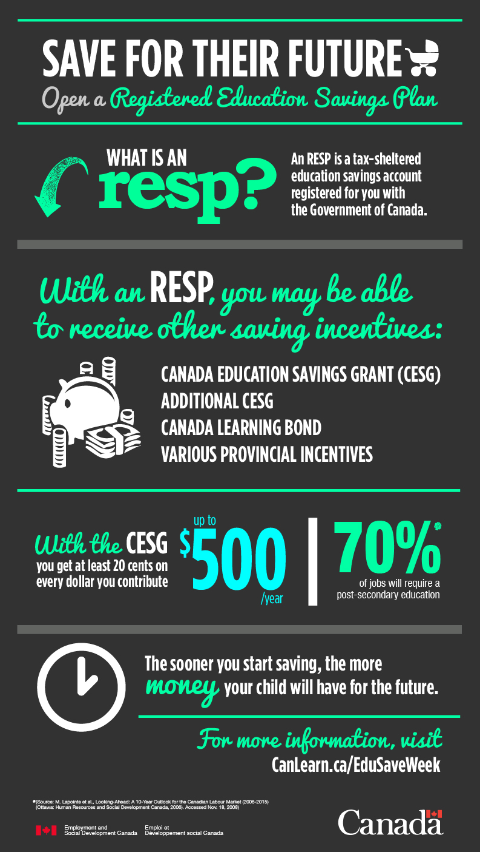
Education Savings Week
A community-led initiative during which various communication activities and events are undertaken with an aim to increase awareness and understanding of the benefits of saving early for a child’s post-secondary education using RESPs, particularly for children from low- and middle-income families.
Education Savings Week coincides with:
Financial Literacy Month (November);
National Child Day (November 20th); and
Financial Planning Week
In 2017, 55 CLB sign-up events were organized by nine CBOs. Events were held across Canada, from St. John’s to Nanaimo, which attracted about 3,400 individuals.
Almost 2,000 RESPs were opened so that the CLB could be requested. 130 SINs were issued by Service Canada.
In support of these events, ESDC mailed over 150,000 letters to PCGs of CLB eligible children.

Slide 12
Help Spread the Word
There are a variety of ways in which you can help increase the awareness of the benefits of saving early for a child’s post-secondary education using RESPs; and Employment and Social Development Canada can help.
Plan an information session for members of your organization
Host a Canada Learning Bond sign-up event
Participate in Education Savings Week
Share information with your networks

Slide 13
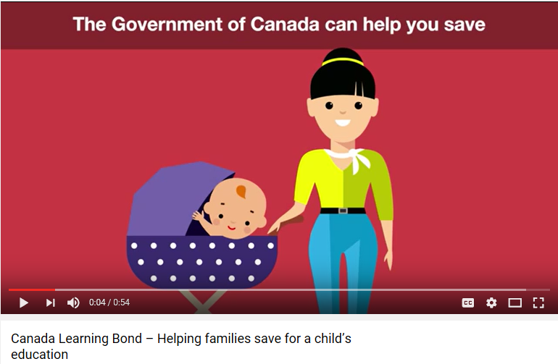
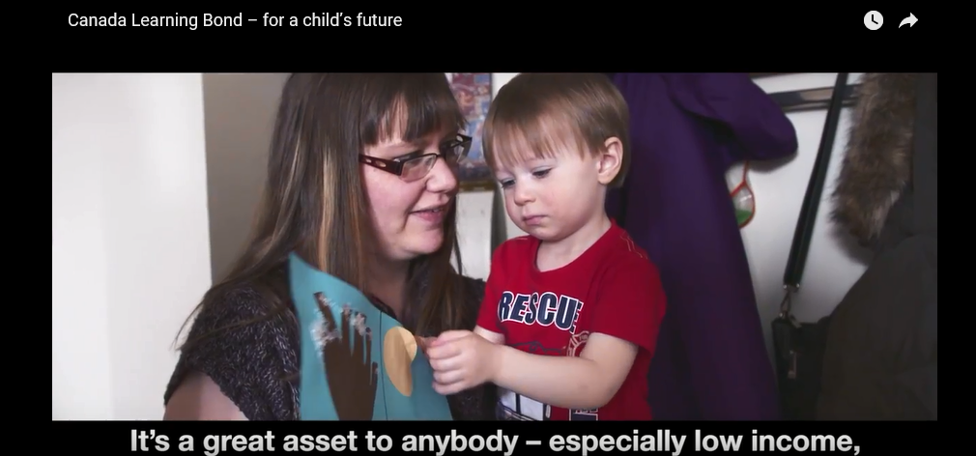
Tools, Resources and Information Products
Promotional products, such as this Infographic, can be distributed at events, shared with your online social network or displayed at your local library.
Additional tools and resources to help you promote the Canada Learning Bond and the Canada Education Savings Grant can be obtained by contacting the Canada Education Savings Program Outreach Team.
https://www.youtube.com/watch?v=scp9z02-kD8
https://www.youtube.com/watch?v=Y8zM3FvXOow

Slide 14
Tools, Resources and Information Products
The Government of Canada’s online portal provides information and resources on education savings via http://Canada.Ca/education-savings
Education Savings Incentives Resource Page provides a networking and information sharing platform via https://gccollab.ca/groups/profile/95754/
For more information on RESPs and the education savings incentives:
1 800 O-Canada (1-800-622-6232)
TTY: 1-800-926-9105

Slide 15
Contact Us
Outreach mailbox
CESP-PCEE-OUTREACH-SENSIBILISATION@hrsdc-rhdcc.gc.ca
For more information on the CLB and CESG
Visit:
canada.ca/education-savings
Or Call:
1 800 O-Canada (1-800-622-6232)
TTY: 1-800-926-9105

